Slide 1
PRESENTATION TITLE
Loan Prediction at Standard Bank
By Roy Rangga Rofiul Azmi
23/02/2023

Slide 2
TEXT LAYOUT 1
Agenda
Data Science Lifecycle​
Project Overview​
Data
Analysis
Modeling
Model Evaluation
Recommendations

Slide 3
Data Science Lifecycle
CRISP-DM life cycle methodology
Business Understanding
Data Understanding
Data Preparation
Modeling
Evaluation
Deployment

Slide 4
TEXT LAYOUT 1
Project Overview
Business Problem | : | Time allocation for loan processing
Business Objective | : | Speed up the loan processing
Hypothesis | : | The historical applicants would gives us the insight about each applicant. Moreover we can use these data to predict the eligibly of the applicant for accepting loan

Slide 5
TEXT LAYOUT 1
Process Overview / Solution
Applicant fill the necessary information
Machine learning assessment
Machine learning decide the loan applications

Slide 6
TEXT LAYOUT 1
Data
614 rows/records
13 features
Consist of categorical data type (object dtype), float and integer data type
Outliers (ApplicantIncome, CoApplicantIncome, Loan Amount term, Credit History)
Missing value (Gender = 24, Married = 3, Dependents = 25, Self Employed = 55, Loan Amount Term = 20 and Credit History = 79)

Slide 7
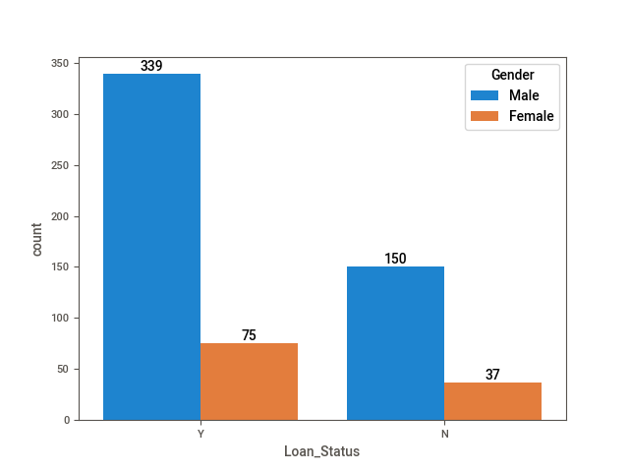
Analysis
The Comparison of the number of loan status along with Gender

Slide 8
TEXT LAYOUT 1
Modeling
Machine learning model has trained whether using manualy approach / Bespoke and AutoML as well
In Bespoke model, the data has preprocessed, validated, and parameter tuned as well, while AutoML hasn’t
Bespoke model have a better accuracy score than the AutoML

Slide 9
Model Evaluation
 | AutoML | Bespoke sklearn
Model used | Auto sklearn | Logistis regression
Accuracy | 78.8% | 81.84% (after parameter tuning)
EDA | sweetviz | Manual (seaborn)

Slide 10
TEXT LAYOUT 1
Recommendations
Bespoke ML:
using model validation to obtain a valid accuracy
do a hyperparameter tuning using gridsearch in order to find a best parameter combination
AutoML :
do a hyperparameter tuning to boost the accuracy
Make a treatment to tackling outliers
Add more data records, in order to make a better training for the model

